Slide 1
CHAPTER 2
BINARY
NUMBERS

Slide 2



QUIZ
COMPETITION
5 MIN
CLASS
Powers of 2
64
2
128

Slide 3
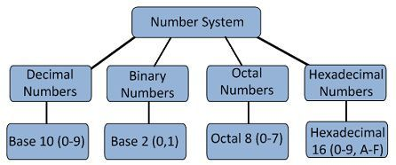
A Numeral System is a writing system for expressing numbers
Some example of Number Systems:

Slide 4
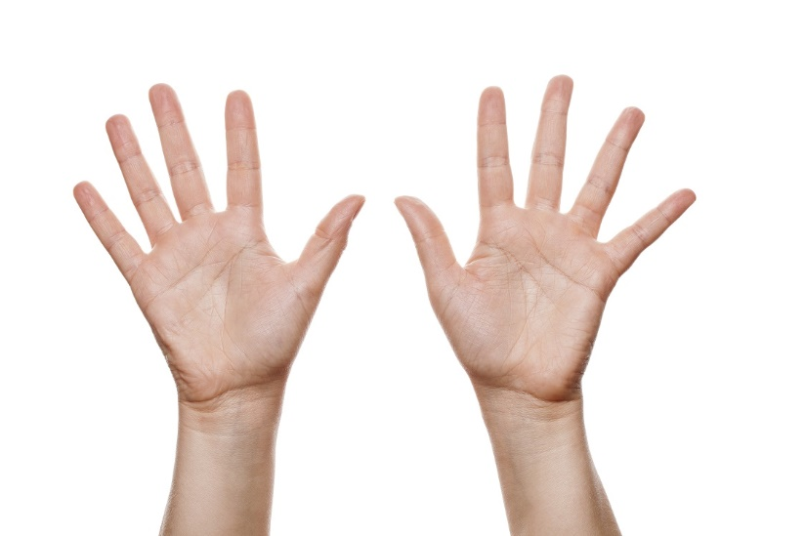
A decimal value is expressed with 10 digits
2
3
6
7
1
8
4
5
9
0

Slide 5
Each slot has a weight ( powers of 10)
17 = 1*10^1 + 7*10^0
SLOT
SLOT
1
7
10^4
10^3
10^2
10^1
10^0
WEIGHT
4
3
2
1
0

Slide 6
COLLECTIVE
With 3 slots, how many numbers can we express in decimal system?
CLASS
10^4
10^3
10^2
10^1
10^0
4
3
2
1
0

Slide 7
COLLECTIVE
CLASS
4
1
7
0
0
What happens if I add a zero here?
What happens if I insert a zero here?

Slide 8
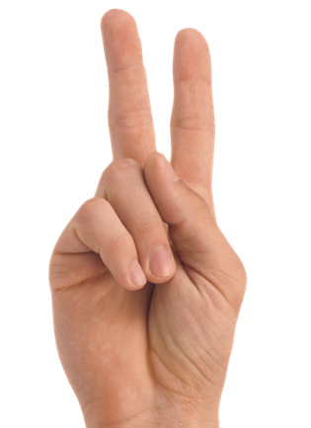
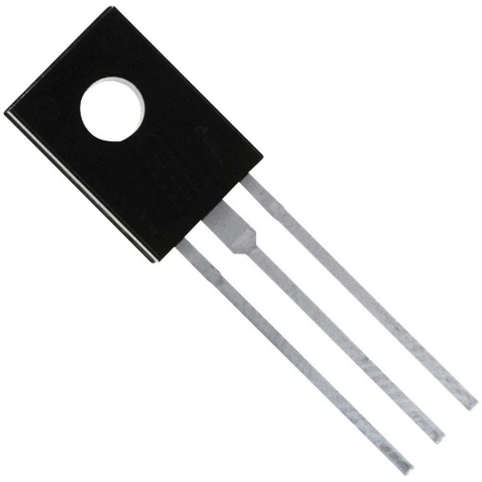
“binary” is a number system using only 2 digits
0
1
A BIT (Binary digit )
Capacitor values: OFF (0) or ON (1)

Slide 9
Each slot has a weight ( powers of 2)
3 = 1*2^1 + 1*2^0
SLOT
SLOT
1
1
2^4
2^3
2^2
2^1
2^0
WEIGHT
4
3
2
1
0

Slide 10
COLLECTIVE
CLASS
With 3 slots, how many numbers can we express in binary system?
2^2
2^1
2^0
2
1
0

Slide 11
COLLECTIVE
What is the value of this number ?
CLASS
1
1
0
1
2^4
2^3
2^2
2^1
2^0

Slide 12
SOLUTION
What is the value of this number ?
1
1
0
1
2^4
2^3
2^2
2^1
2^0
16
8
4
2
1
8 * 1 + 4 * 1 + 2 * 0 + 1* 1 = 13

Slide 13



Game !!!
10 MIN
GROUPS OF 5
1
0
1
0
1
*16
*8
*4
*2
*1

Slide 14
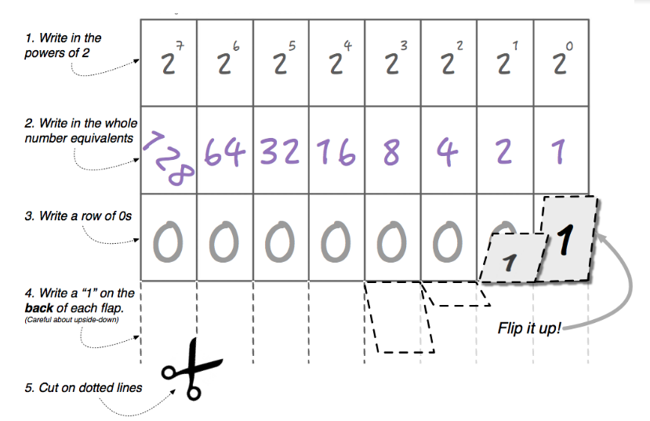
PRACTICE
Complete your flippy & do the exercises
30 MIN
INDIV

Slide 15
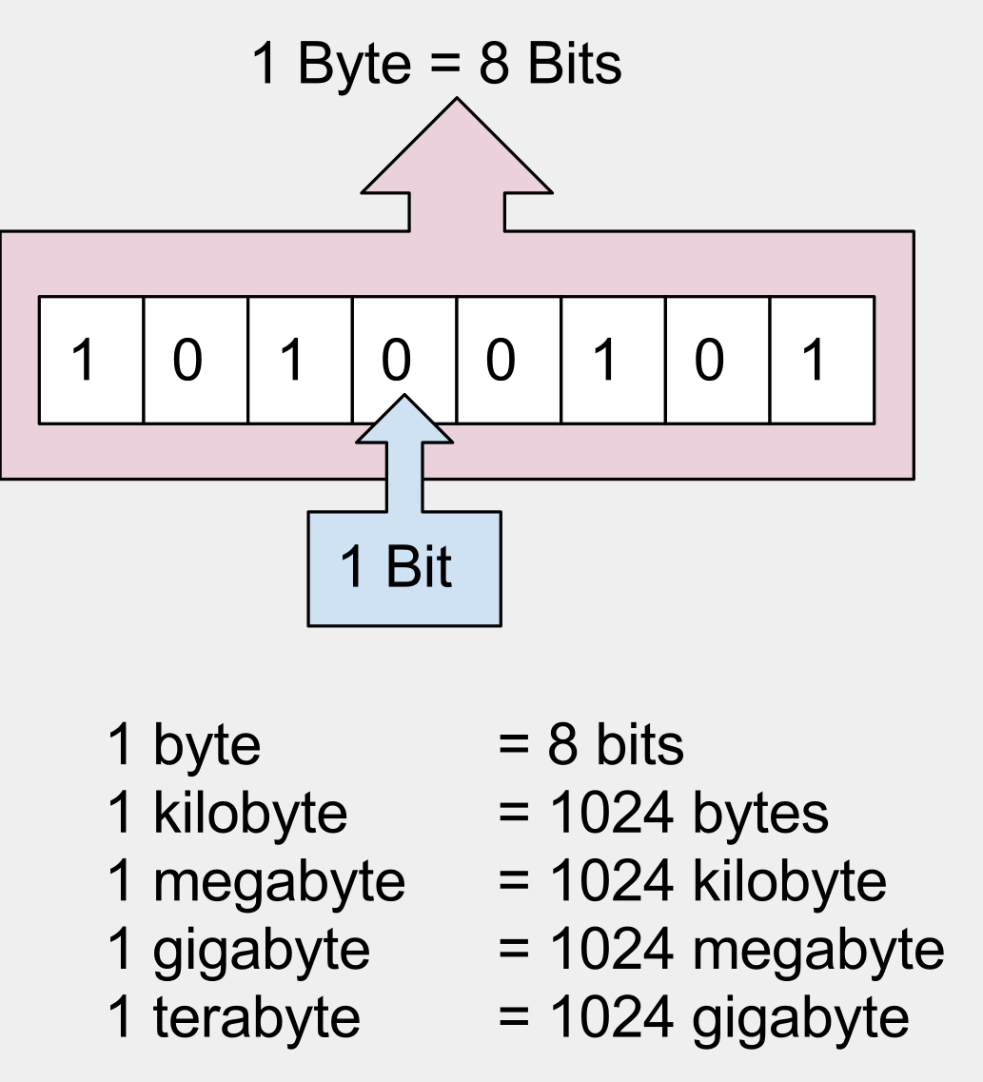
More than a bit, a BYTE !

Slide 16
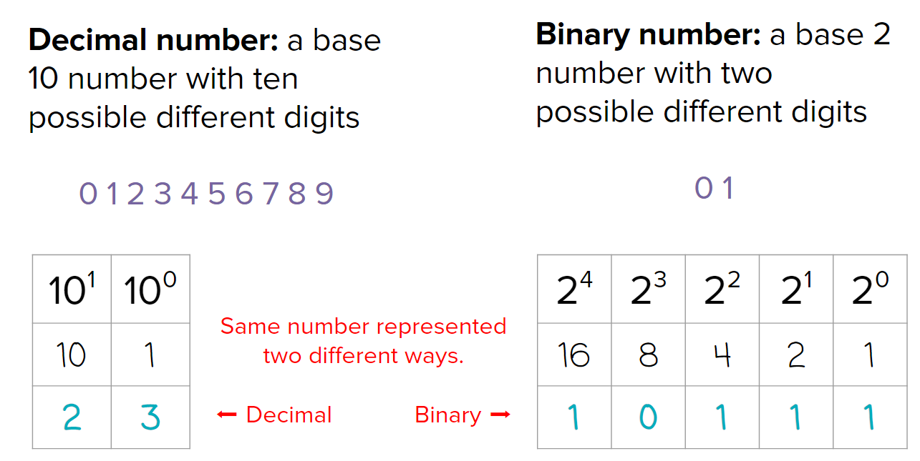
WRAP UP
What did we learn today?

Slide 17

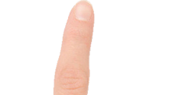
HOMEWORK
INDIV
Count in base 11 !!
2
3
6
7
1
8
4
5
9
0
A

